Slide 1
Bank of Ireland Home
User Experience review
Paul Chapman
2nd October 2013
Notes:
1

Slide 2
Project Introduction
The objective is to re-design the existing home quote & buy journey, making changes to the web front-end only.
The redesign must increase conversion and product upsell, whilst putting Bank Of Ireland to the front of the market (alongside 123.ie and AA).
All design proposals need to comply to the RSA and Bank of Ireland Compliance guidelines (according to CPC), as well as Bank of Ireland’s Brand guidelines.
Notes:
2

Slide 3
Key Deliverables
A low-fi wireframe prototype for internal review and buy-in purposes
Visual design style guide
Front end build & test ready for implementation
“Light touch” support throughout the implementation and launch
Notes:
3

Slide 4
The Global E-Business Design Process
Task | Action
1. Understanding the business’ needs | Kick off meeting
2. Understanding the users’ needs | Journey mapping Competitor review Competitor comparison
3. Defining the journey (UX) | Usability review Design principles
4. Creating a new design | UI Sketching Interaction prototyping Brand exploration Visual Design
Notes:
4

Slide 5
Understanding the users’ needs
Notes:
5

Slide 6
User Journey
The Bank of Ireland Home journey
Point of sale
Eligibility Criteria
Quick Quote
Quote 2
Quote Summary
Payment
Policy Confirmation
Bank of Ireland Insurance
Details Capture
Retrieve
Ineligible / Hand off
Ineligible / Hand off
Bank of Ireland
RSA
Notes:
6

Slide 7
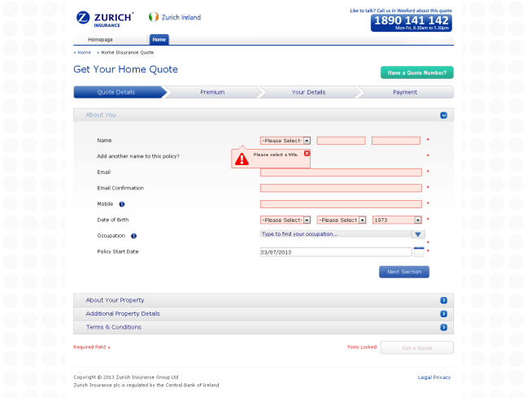
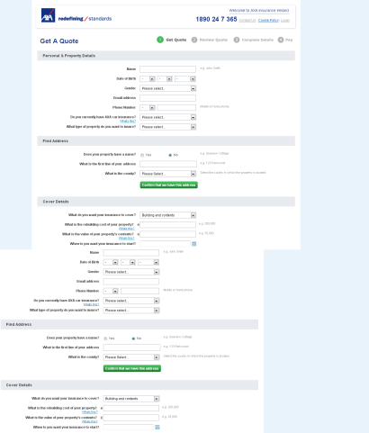
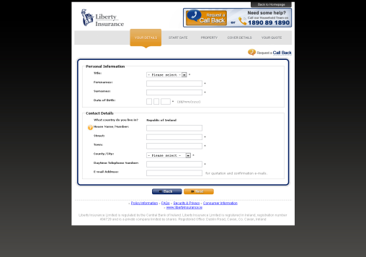
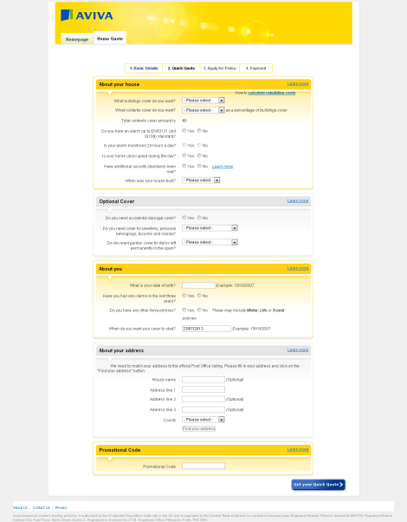
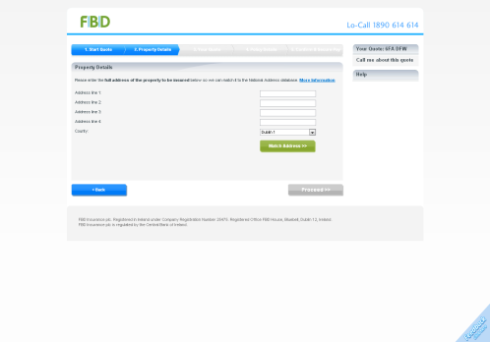
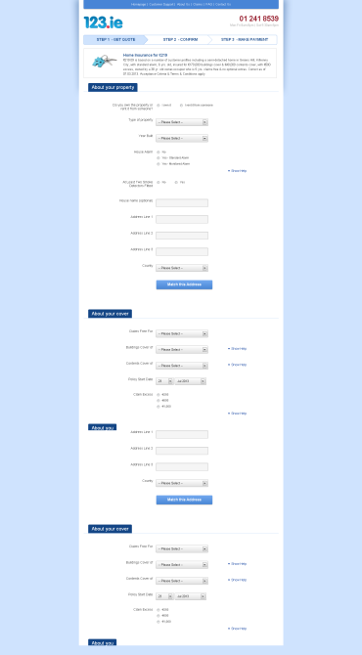
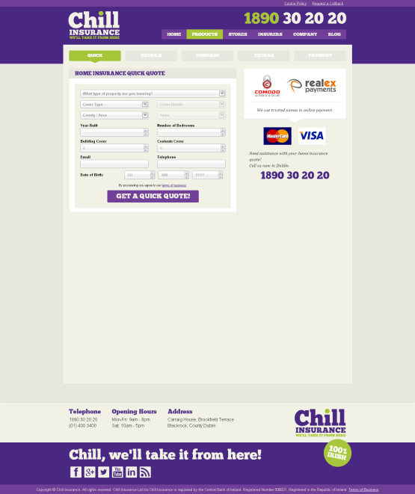
Overview of the market
Strong
Poor
123.ie has been selected as the benchmark for this project. This is based on their market share, conversion rate and overall UX.
Competitor journeys are generally quite poor in the areas of usability & responsive design.
Notes:
7

Slide 8
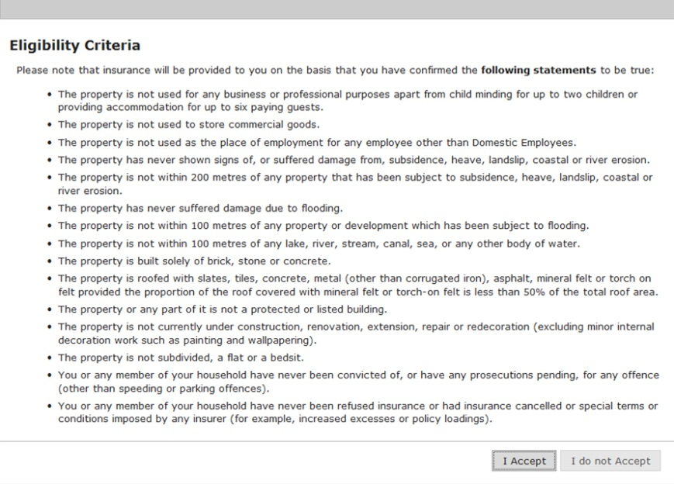
Overview of the market– Common Themes 1
Dealing with Eligibility
Bank of Ireland currently uses a heavily-written mobile unfriendly overlay, this will need to be resolved.
Notes:
8

Slide 9
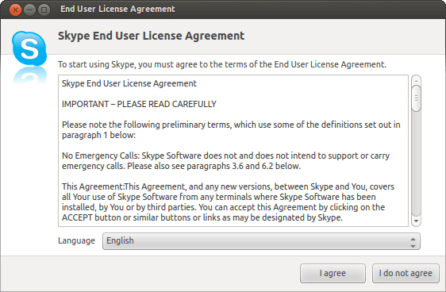
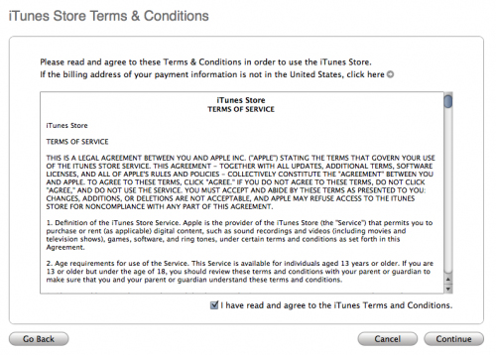
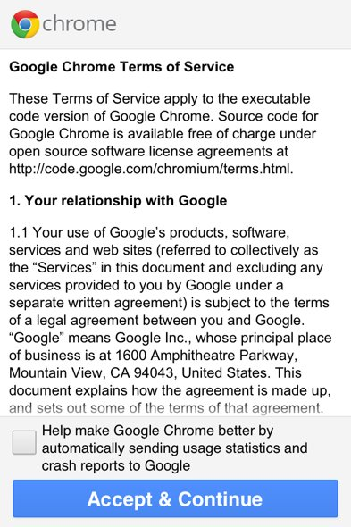
Overview of the market– Common Themes 2
Dealing with Eligibility
We propose dealing with this by placing the Eligibility message in a scroll box on the page, rather than a overlay. Some examples are shown here.
Notes:
9

Slide 10
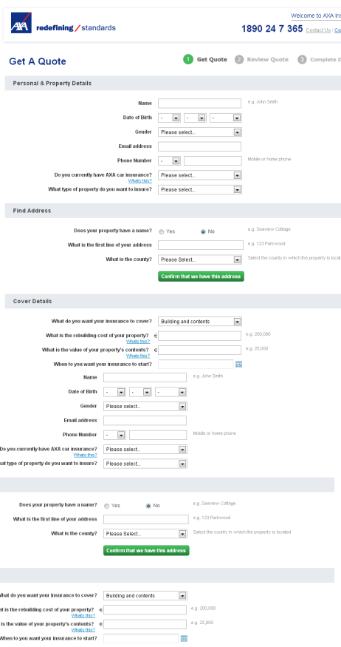
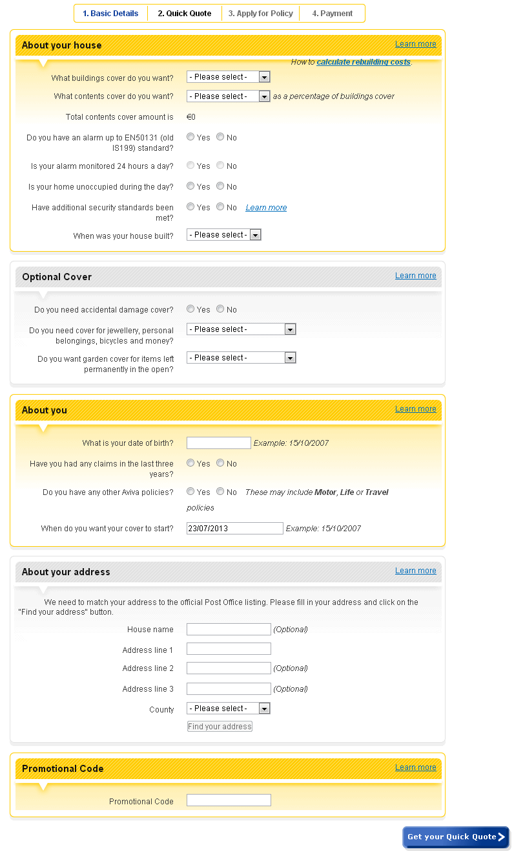
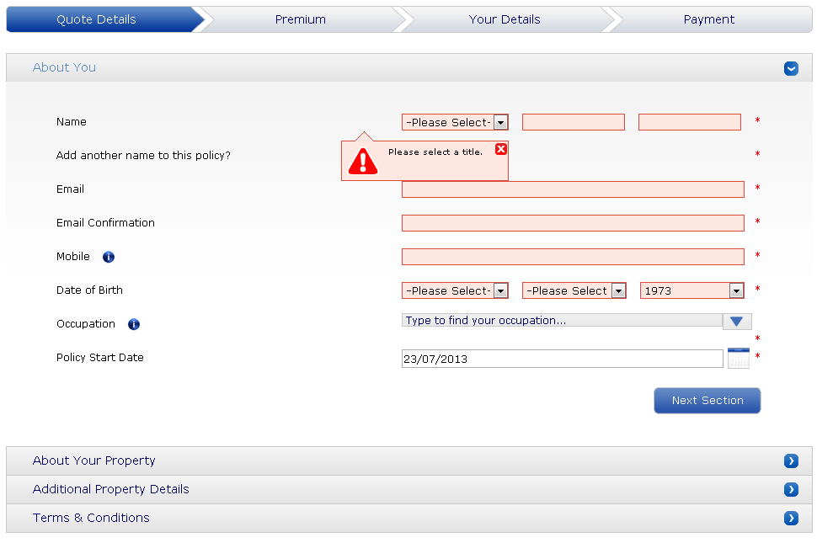
Overview of the market– Common Themes 3
Details Captures
Long question sets can hurt conversion and so information needs to be structured into smaller bit sized chunks, which help the user digest this information.
Notes:
10

Slide 11
Proposed Solutions
How we can improve the UX
Notes:
11

Slide 12
User Journey
With the removal of quick quote and a few content adjustments, we believe a smoother UX could be achieved.
Point of sale
Details Capture
Quote
Check Your Details
Payment
Confirmation
About Home, Cover and You
Bank of Ireland Insurance
Retrieve Journey
Ineligible / Hand off
Bank of Ireland
RSA
Notes:
12

Slide 13
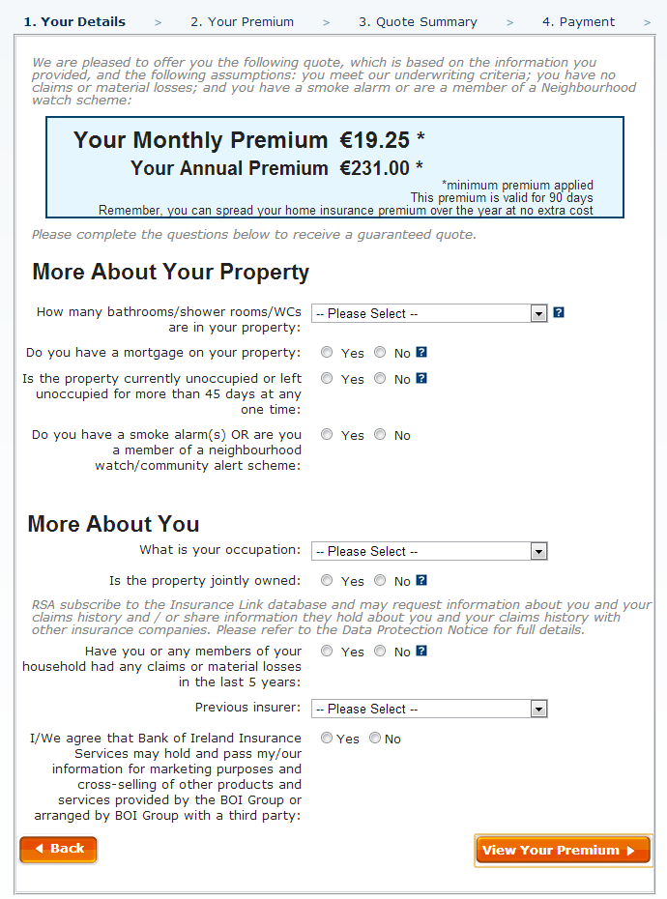
Removal of Quick Quote
The new journey removes Quick Quote. After completing Step 1 users now get a quote which is obtainable based on them being eligible.
This is because Eligibility questions have been included in Step 1.
This removes the problem of customers getting a quote at the ‘Quick Quote’ stage only for them to then be told they are ineligible based on subsequent questions.
People have filled out questions to get a quote. They don’t then want to be faced with more questions.
Notes:
13

Slide 14
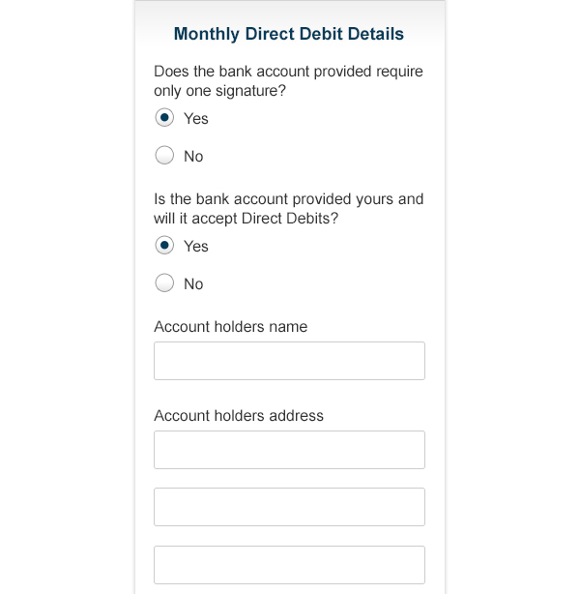
Clean, more accessible, visual design
This project is a great opportunity to provide a more user-accessible UI.
By taking a mobile first approach to the project ensures we have the most streamlined Journey possible.
With added vertical spacing and clearer, larger input fields and call to actions, users will find it easier to read and interact with the Journey, improving the UX substantially.
Notes:
14

Slide 15
NEXT STEPS
Visual Design & Front-End Development
Compliance Review
Client Presentation
Notes:
15

Slide 16
THANK YOU
Any questions? paul.z.chapman@uk.rsagroup.com
Notes:
16

